Slide 1
React JS

Slide 2
Single Page Application

Slide 3
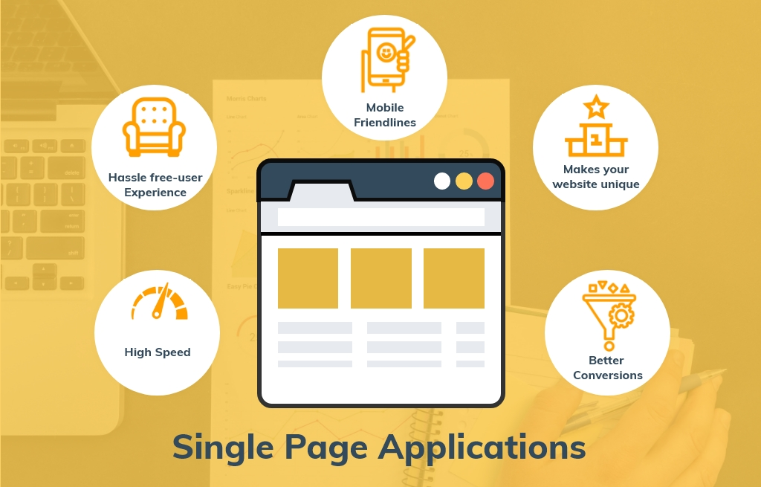
Single Page Application

Slide 4
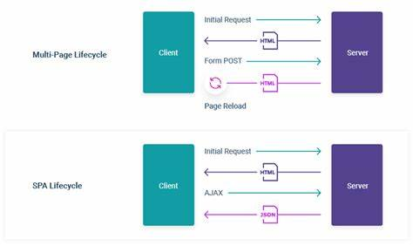
Multipage Vs Single Page Application

Slide 5
What is React Js?
React JS is basically a JavaScript library built and maintained by Facebook
Tutorial: Intro to React – React (reactjs.org)

Slide 6
Why React?
Develop User interfaces(UI) that improves the speed of the apps
Uses virtual DOM(JavaScript Object)
Tutorial: Intro to React – React (reactjs.org)

Slide 7
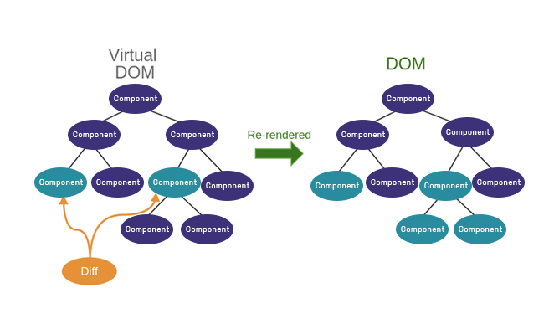
Virtual DOM
Virtual DOM and Internals – React (reactjs.org)

Slide 8
Advantage
Simple and Easy
Faster Rendering
React Native for mobile app development
SEO-friendly
Codes stability
Testability

Slide 9
React APP – Know More
Add React to a Website – React (reactjs.org)
ReactDOM – React (reactjs.org)
DOM Elements – React (reactjs.org)
React Top-Level API – React (reactjs.org)
React Without JSX – React (reactjs.org)

Slide 10
React App
Using HTML & JS
Visual Studio Code
Live Server
ES7-Enable

Slide 11
JSX – JavaScript XML
Introducing JSX – React (reactjs.org)
https://babeljs.io/docs/en
https://babeljs/docs/en/babel-standalone
Javascript XML – Extension to javascript language syntax
Writing XML like code for elements and components
JSX tags have tag name,attributes, and children

Slide 12
React Components
https://reactjs.org/docs/components-and-props.html
View
Reusable
Types
Stateless Functional Components(changed in 16.8 using hooks)
Statefull class Components

Slide 13
React App
https://nodejs.org/en/download/
node –version
npm -v
Using React App
using Package Runner(npx)
using Package Manager(npm)
npx create-react-app sampleapp

Slide 14
Component Lifecycle
https://projects.wojtekmaj.pl/react-lifecycle-methods-diagram/
https://reactjs.org/docs/react-component.html
https://react-md.dev/guides/creating-a-new-app

Slide 15
Class Component and State
State is updatable structure used to store data or information
http://reactjs.org/docs/state-and-lifecycle.html
https://reactjs.org/blob/2018/06/07/you-probably-dont-need-derived-state.html

